Slide 1
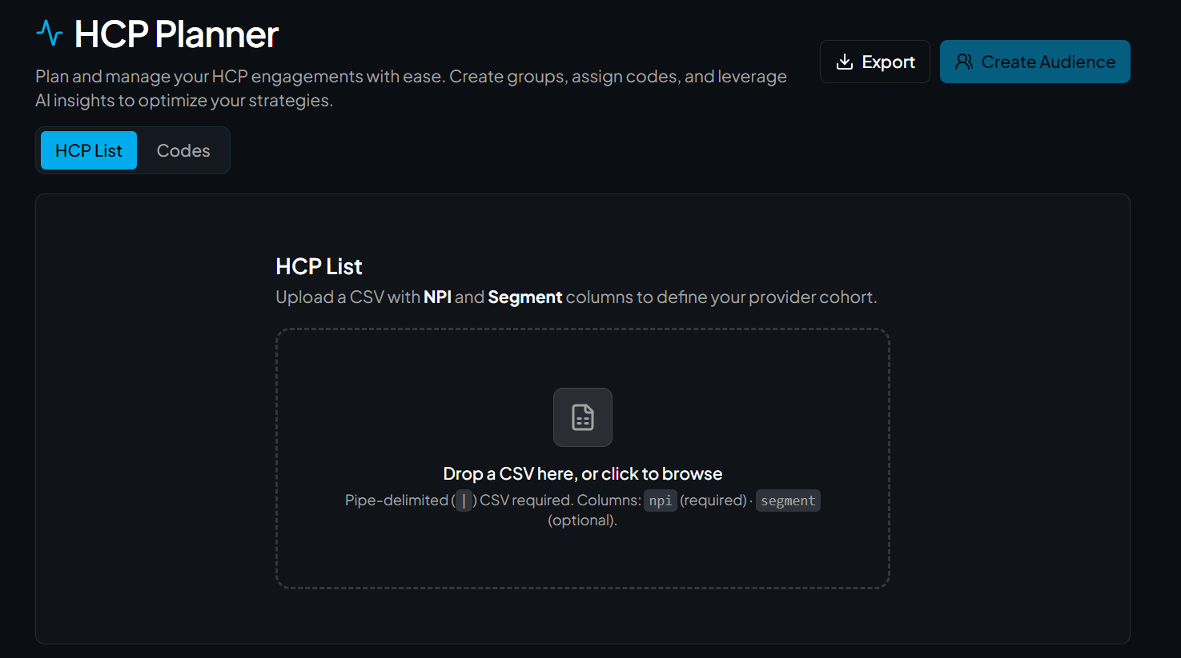
HCP List Upload
# | Event | Details
1 | Click | Select desired CSV file to upload
HCP List Upload
Users can upload a Comma Separated Values (CSV) file to the HCP list selection
Format should include NPI and Segment columns to define your provider cohort
1

Slide 2
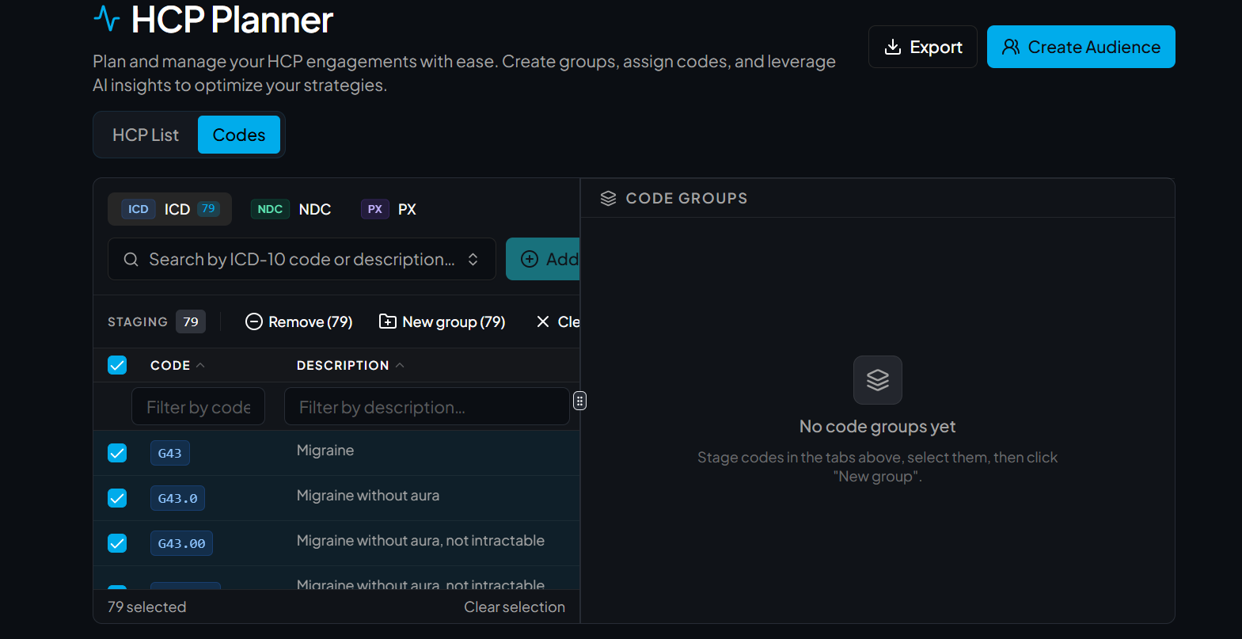
Creation of Code Groups
# | Event | Details
1 | Click | Select ICD-10, then interact
2 | Click | Select NDC Icon, then interact
3 | Click | Select PX Icon, then interact
4 | Click | Select “new group”, name code group
2
3
1
Users can create code groups by searching and choosing ICD – 10, NPC, and PX codes
ICD-10: Search by name and select desired codes – user has the option to filter by code and description
NDC: User can search by NDC, brand or generic name
PX: User can search by HCPCS or by description
“New group” prompts user to name the code group
4

Slide 3
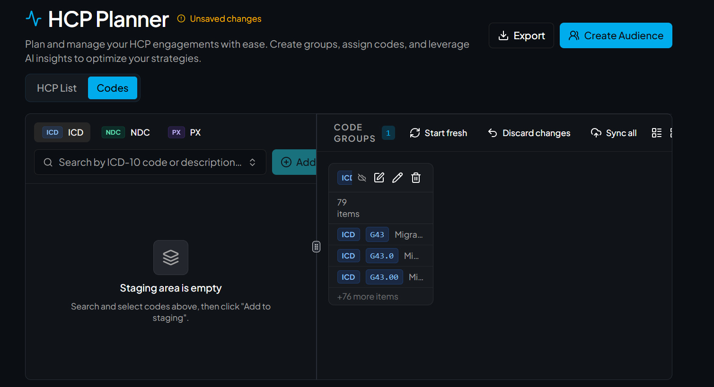
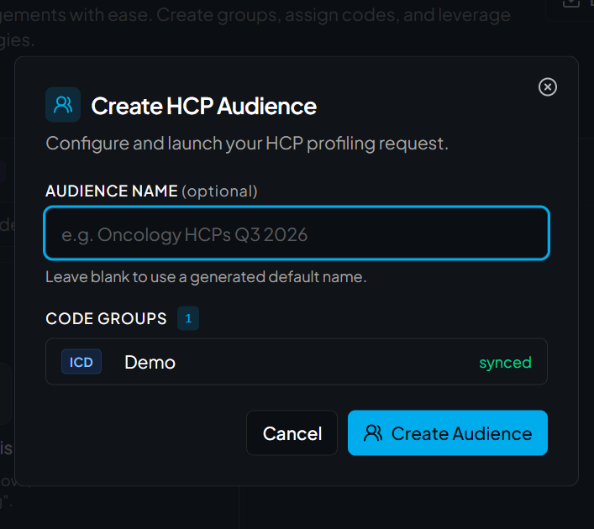
Create Audience
2
# | Event | Details
1 | Click | Sync audience saves code group
2 | Click | Create Audience to start building
3 | Click | Name HCP Audience to initiate job
1
User selects “Create Audience” at the top
Prompted to name the audience and select desired code groups to be included
Select create Audience and the process begins
Once finished, user can download audience as a .XLSX or Parquet file
3

Slide 4
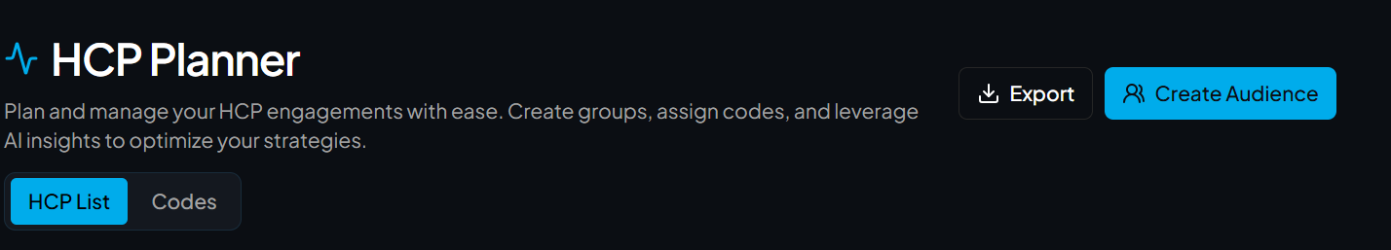
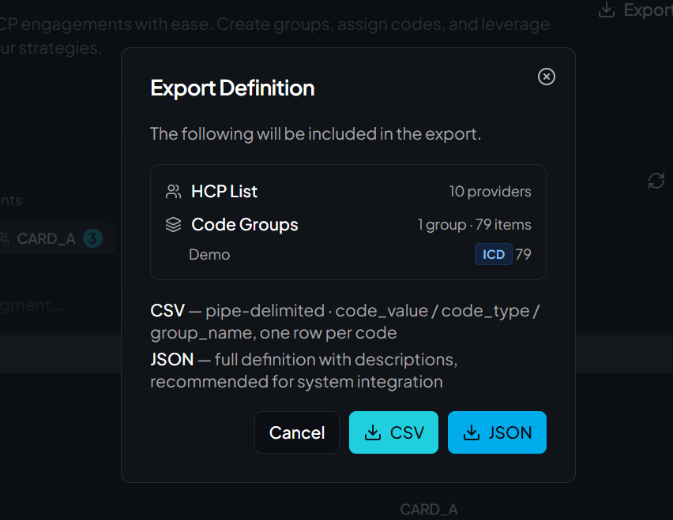
Export Definition
# | Event | Details
1 | Click | Click Export to initiate process
2 | Click | Click CSV to export definition as a CSV file
3 | Click | Click JSON to export as a JSON file
1
Users can take HCP List and Code Group/s to export as a CSV or JSON file in the export button
2
3

Slide 5
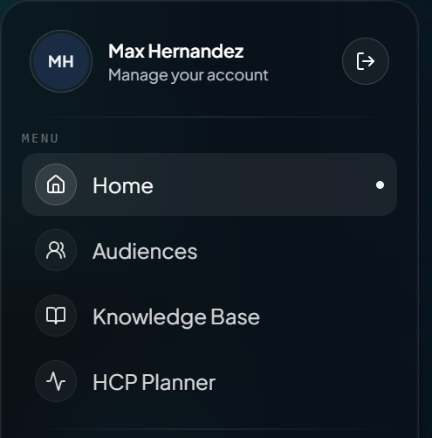
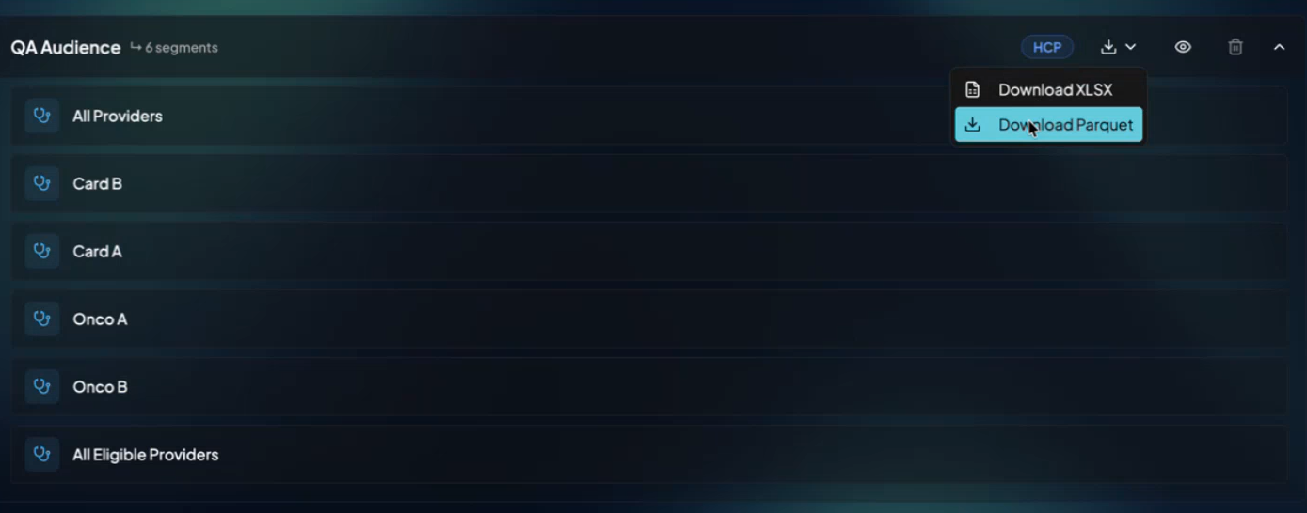
Download File
# | Event | Details
1 | Click | Open the audience tab to access the HCP planner job
2 | Click | Dropdown arrow allows user to view all segments
3 | Click | Download button to access download options
4 | Click | Select either XLSX or Parquet
1
3
Once HCP audience is finished, user can access profile and all segments in the hamburger menu dropdown
User can choose to download as a .XLSX or Parquet file
2
4

